Slide 1
Processes
Process Concept
Process Scheduling

Slide 2
Process Concept
An operating system executes a variety of programs:
Batch system – jobs
Time-shared systems – user programs or tasks
Textbook uses the terms job and process almost interchangeably.
Process – a program in execution; process execution must progress in sequential fashion.
A process includes:
program counter
stack
data section

Slide 3
Process State
As a process executes, it changes state
new: The process is being created.
running: Instructions are being executed.
waiting: The process is waiting for some event to occur.
ready: The process is waiting to be assigned to a process.
terminated: The process has finished execution.

Slide 4
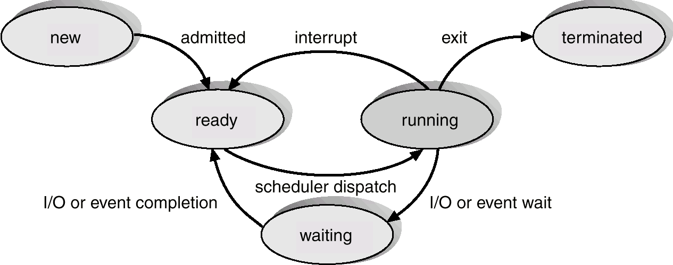
Diagram of Process State

Slide 5
Process Control Block (PCB)
Information associated with each process.
Process state
Program counter
CPU registers
CPU scheduling information
Memory-management information
Accounting information
I/O status information

Slide 6
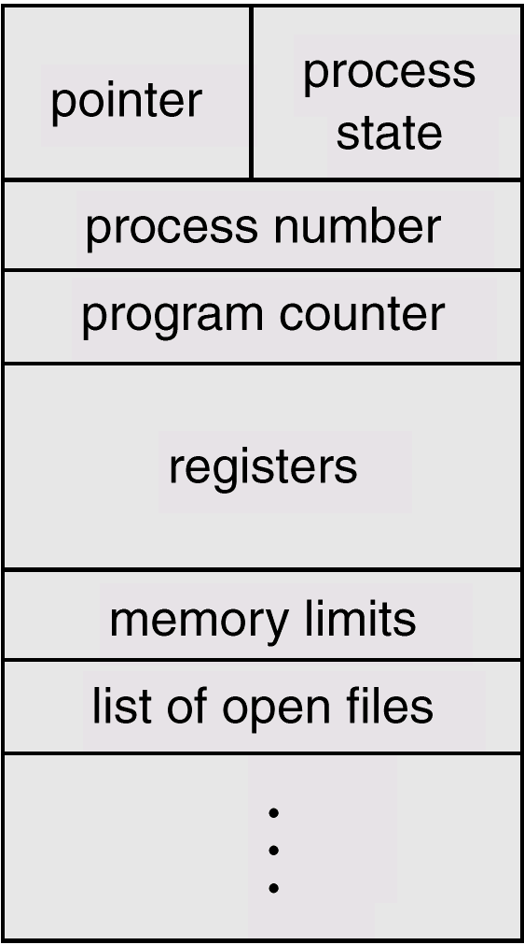
Process Control Block (PCB)

Slide 7
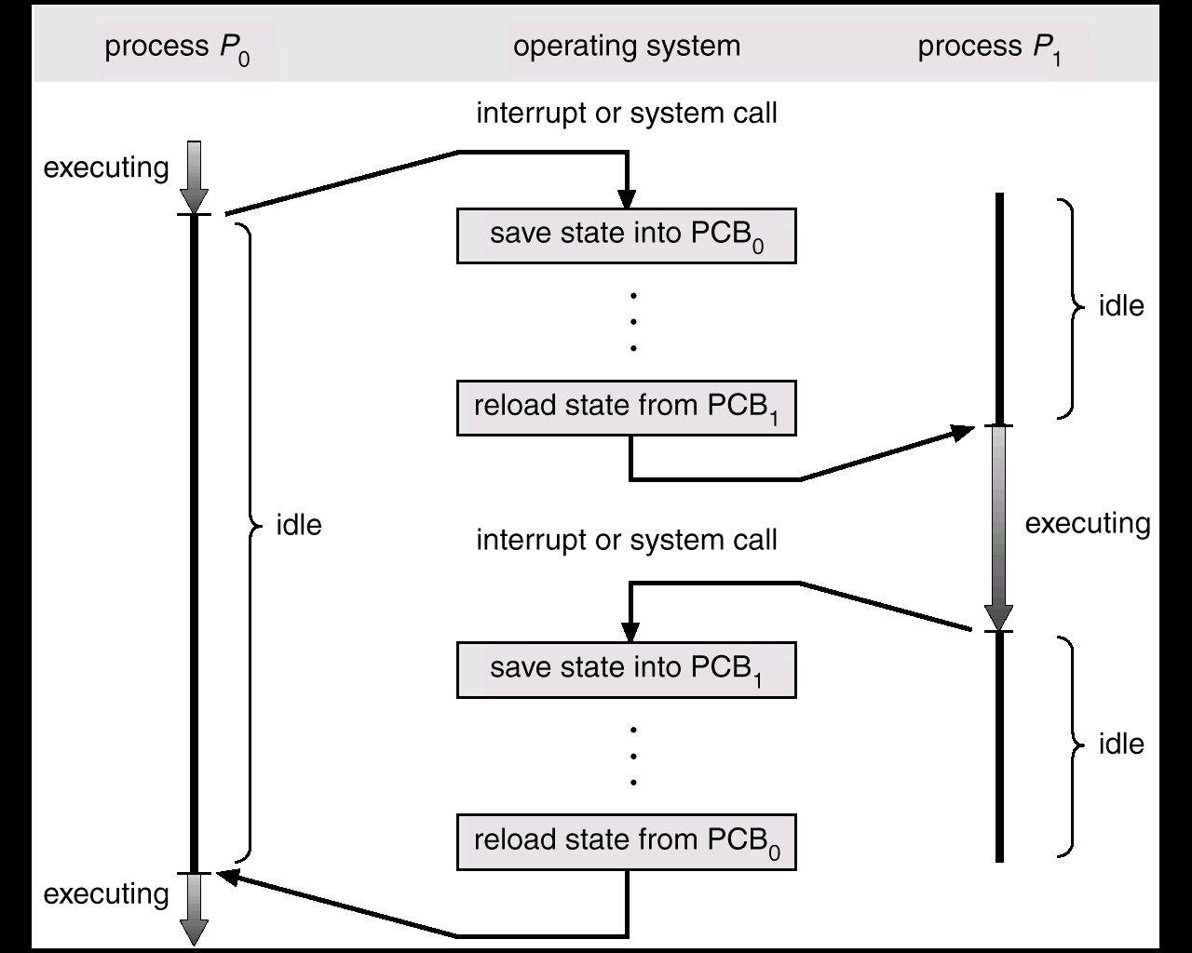
CPU Switch From Process to Process

Slide 8
Process Scheduling Queues
Job queue – set of all processes in the system.
Ready queue – set of all processes residing in main memory, ready and waiting to execute.
Device queues – set of processes waiting for an I/O device.
Process migration between the various queues.

Slide 9
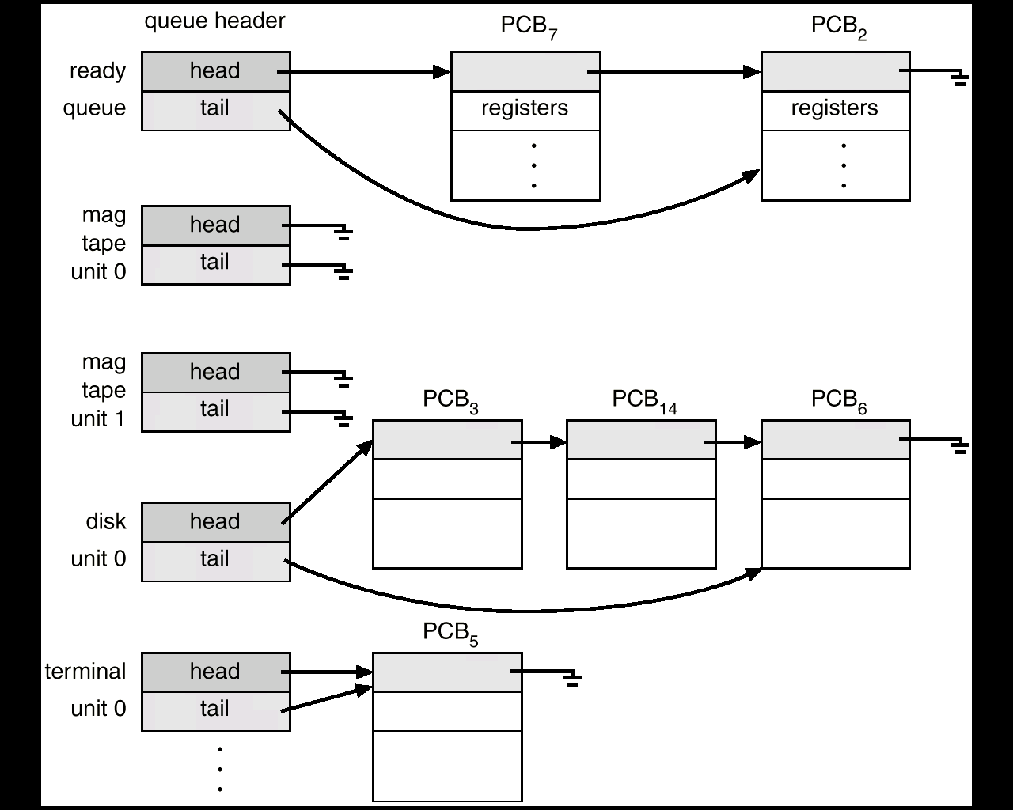
Ready Queue And Various I/O Device Queues

Slide 10
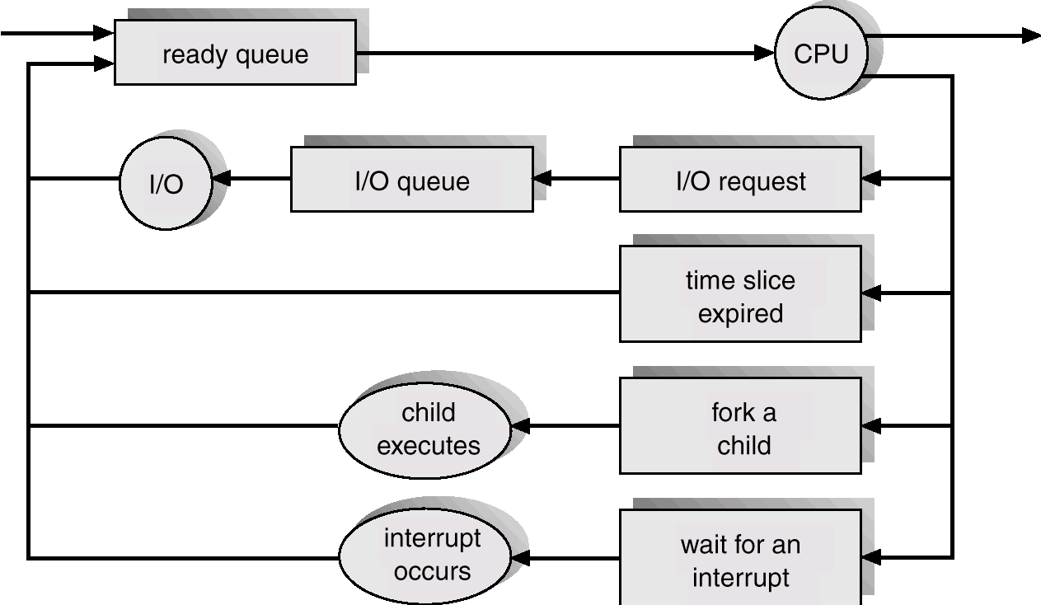
Representation of Process Scheduling

Slide 11
Schedulers
Long-term scheduler (or job scheduler) – selects which processes should be brought into the ready queue.
Short-term scheduler (or CPU scheduler) – selects which process should be executed next and allocates CPU.

Slide 12
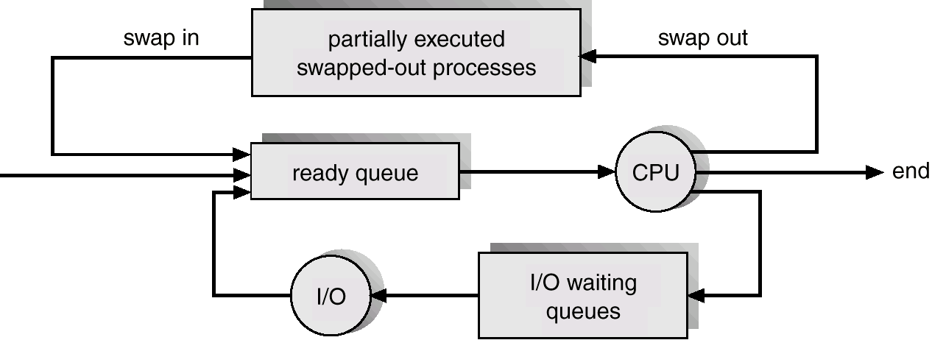
Addition of Medium Term Scheduling

Slide 13
Schedulers (Cont.)
Short-term scheduler is invoked very frequently (milliseconds) ⇒ (must be fast).
Long-term scheduler is invoked very infrequently (seconds, minutes) ⇒ (may be slow).
The long-term scheduler controls the degree of multiprogramming.
Processes can be described as either:
I/O-bound process – spends more time doing I/O than computations, many short CPU bursts.
CPU-bound process – spends more time doing computations; few very long CPU bursts.

Slide 14
Context Switch
When CPU switches to another process, the system must save the state of the old process and load the saved state for the new process.
Context-switch time is overhead; the system does no useful work while switching.
Time dependent on hardware support.

